Slide 1
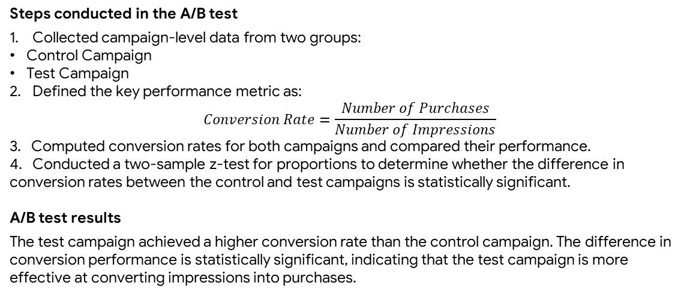
Statistical Review and A/B Testing for Marketing Campaign Performance
Executive Summary Report
Analysis prepared by Data Analyst
This project analyzes the performance of two marketing campaigns using A/B testing. The objective is to determine whether the test campaign is more effective than the control campaign in converting impressions into purchases.
The company ran two different marketing campaigns, but it is unclear which campaign performs better in driving customer purchases. A data-driven evaluation is required to assess whether the observed differences in conversion performance are statistically significant.
An A/B test was conducted to compare the effectiveness of the control campaign and the test campaign using conversion rate (purchases per impression) as the primary metric.
Steps conducted in the A/B test
Collected campaign-level data from two groups:
Control Campaign
Test Campaign
Defined the key performance metric as:
$$Conversion Rate=\frac{Number of Purchases}{Number of Impressions}$$
3. Computed conversion rates for both campaigns and compared their performance.
4. Conducted a two-sample z-test for proportions to determine whether the difference in conversion rates between the control and test campaigns is statistically significant.
A/B test results
The test campaign achieved a higher conversion rate than the control campaign. The difference in conversion performance is statistically significant, indicating that the test campaign is more effective at converting impressions into purchases.
Investigate inefficiencies in Region A
Optimize fleet and operations based on best-performing regions

